Slide 1


Analysis of East Timor (Timor-Leste)
Yishun,Zhang

Slide 2
Overview
Objective: Conduct a comprehensive analysis of East Timor, exploring its economy, resources, and development potential.
Contents:
General Description
Relationships Between GDP and Key Variables
Regional Comparison
SWOT Analysis

Slide 3
General Description
Geographical Location:
Southeast Asia, occupying the eastern half of Timor Island.
Key Facts:
Population: ~1.3 million
Capital: Dili
Official Languages: Tetum and Portuguese
Currency: US Dollar (USD)

Slide 4
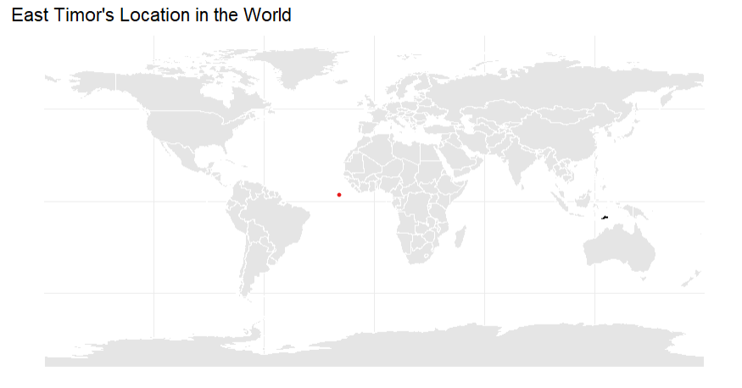
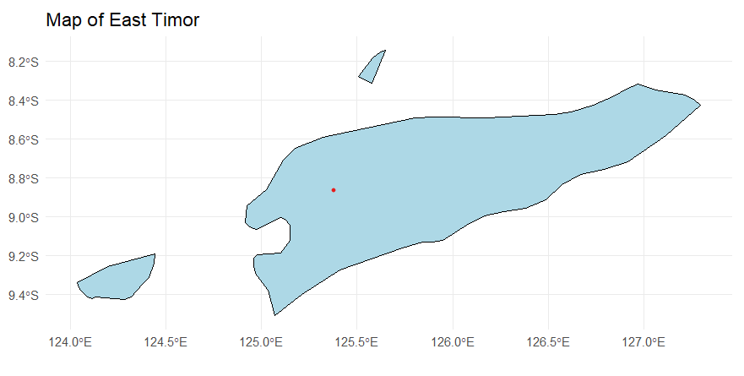
Maps
World map showing its location
Detailed map of the island

Slide 5
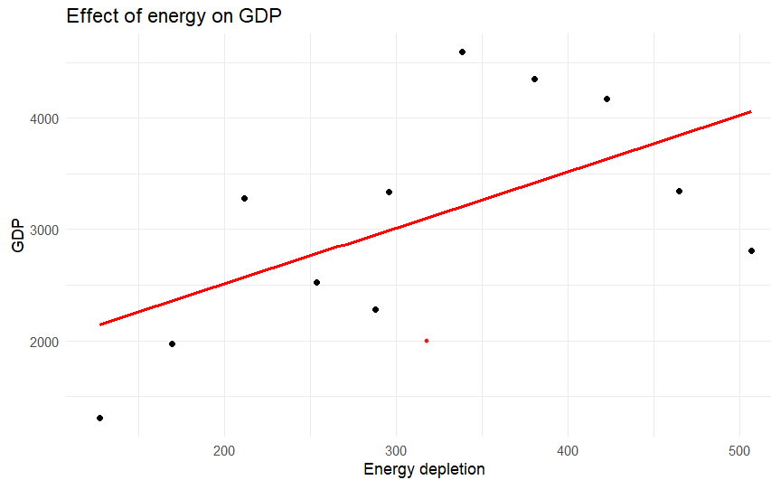
Relationships Between GDP and Key Variables
Variable 1: Energy vs. GDP
Observation: Energy use shows a positive correlation with GDP.
Visualization:

Slide 6
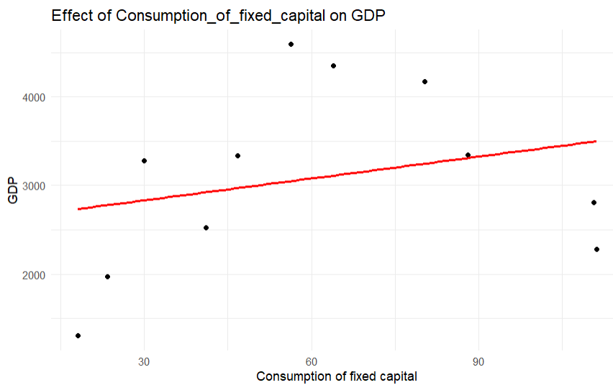
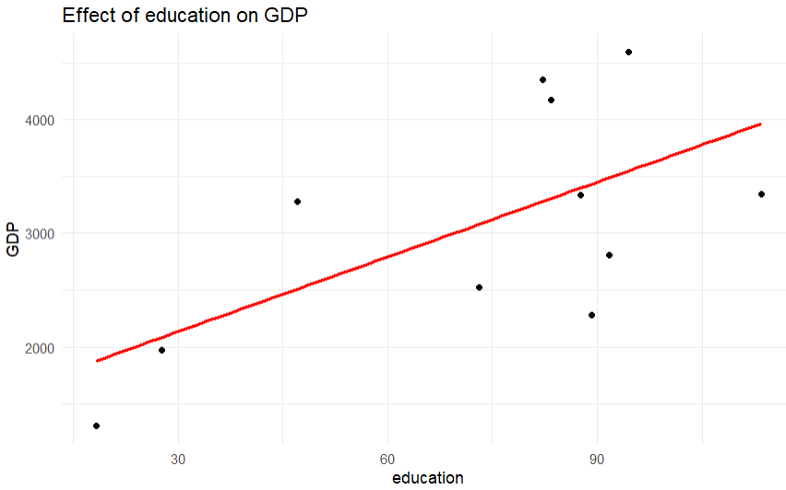
Variable 2: Fixed Capital Consumption vs. GDP
Observation: Moderate positive relationship between fixed capital consumption and GDP.
Variable 3: Education vs. GDP
Observation: Education expenditure shows a weaker positive correlation with GDP.

Slide 7
Regional Comparison
Comparison: East Timor vs. Australia (2016)
Key Data:
East Timor GDP: $2,277 million
Australia GDP: $1,208,000 million

Slide 8
SWOT Analysis
Strength：Rich natural resources, growing GDP
Weakness：Infrastructure development needed
Opportunity：Potential for tourism and regional trade
Threat：Impact of climate change and political stability

Slide 9
Conclusion
Summary:
East Timor has significant economic potential but needs to overcome infrastructure and political challenges.
Tourism and resource management are key growth areas.
Recommendations:
Strengthen education investment to drive long-term GDP growth.
Improve infrastructure quality to attract foreign investment.

